Slide 1
ENSE 470 Milestone 2
Jeremy Cross
Iden Ellia
Abdullah Alasmari

Slide 2
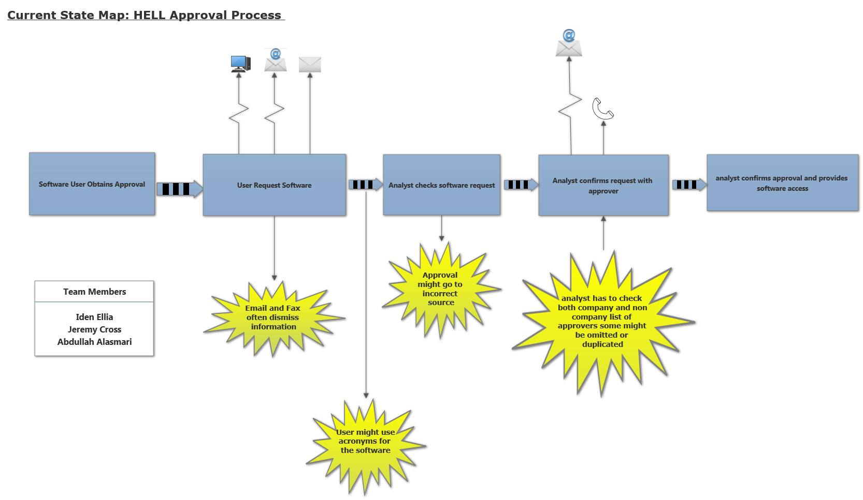
Recalling Current State VSM and Kaizen Bursts

Slide 3
Idea Sheets
Describe your idea sheets and any categories/themes that emerged

Slide 4
Future state VSM
Display your completed future state VSM
Emphasize the differences from the current state VSM
Share reasons for choosing areas to improve

Slide 5
Misc.
Add other insights if you like but remember, your group’s report-out must be kept within 5 minutes

Slide 6
Group reflection
How did you feel about this milestone? What did you like about it? What did you dislike?
[Response here]
What did you learn about yourself as you collaborated and worked through this milestone?
[Response here]
How will you use what you have learned going forward?
[Response here]
What “stuff & things” related to this milestone would you want help with?
[Response here]

